Slide 1

HireSphere: Elevating Hiring Experience
Mohammad Anas Chougle- 23207006
Darshan Korde- 23207003
Snehal Pawar- 23207002
Purva Sawant- 22107026
Project Guide
Prof. Sheetal Jadhav

Slide 2
Outline
Introduction
Literature Survey of the existing systems
Limitations of the existing systems
Problem statement
System Design
Technologies and methodologies
Implementation
Conclusion
References

Slide 3
Introduction
In today's highly competitive academic landscape, attracting and retaining top talent is essential for the success and reputation of our institution. However, the traditional hiring process often faces challenges such as inefficiencies, lengthy decision-making timelines, and lack of transparency. To address these issues and ensure we are recruiting the best candidates effectively and efficiently, we have developed a strategic approach to streamline the assistant professor hiring process.
Motivation
To enhance the hiring process, we're implementing a streamlined system where candidate resumes are assessed by qualifying staff, a dedicated committee.
This will help companies to save time, as the candidate has to go through the qualifying and approval process before interview. This will help finding potential candidate.

Slide 4
Introduction
Objectives
To highlight features that improve the candidate experience, such as user-friendly interfaces, personalized communication, and quick response times.
To improve hiring quality as the candidate resumes are reviewed by qualifying staff, committee, and finally approved by the instructor for a follow-up interview, ensuring the best candidate is selected.
To safeguard sensitive candidate information and to ensure data Security role-based access controls are used.

Slide 5
Literature Survey of the existing system
Sr No. | Title | Author | Year | Methods Used | Merits
1. | [1] Requirement Analysis Document for Recruitment Management System. | Berihun, Natnael. | 2021 | Conduct interviews with stakeholders such as HR managers, recruiters, hiring managers, and candidates to gather their requirements, and expectations regarding the recruitment process. | Detail the specific features and functions the system must perform. This could include job posting, candidate sourcing, applicant tracking, interview scheduling

Slide 6
Literature Survey of the existing system
Sr No. | Title | Author | Year | Methods Used | Merits
2. | [2] CAMPUS RECRUITMENT SYSTEM . | Dr. Amit Kapoor. | 2022 | Streamlining the application process through a user-friendly online portal, making it easier for both candidate and recruiters. | Campus recruitment enables organizations to streamline the hiring process. This can significantly reduce the time-to-hire, allowing organizations to fill critical roles more quickly.

Slide 7
Literature Survey of the existing system
Sr No. | Title | Author | Year | Methods Used | Merits
3. | [3] A Comprehensive Campus Recruitment and Placement System for Optimizing the Hiring Process | Sunil Palia, Jitesh Vohra | 2022 | A well-organized system with clear communication and timely feedback enhances the overall experience for both selected and non-selected candidates, fostering a positive image of the organization. | Utilizing online platforms and portals specifically designed for campus recruitment allows organizations to reach a broader audience
his book explores various yearbook methods, detailing their merits and how they contribute to an efficient and effective campus recruitment and placement system.

Slide 8
Limitations of existing systems
Existing systems face limitations such as inefficiencies, prolonged decision-making, and lack of transparency.
Survey analysis highlights challenges and stakeholder dissatisfaction.
The problem remains far from complete resolution.
Improvement possibilities include streamlining processes and enhancing communication.
We feel confident in addressing issues and contributing to the solution.

Slide 9
Problem statement
The current assistant professor hiring process in academic institutions faces challenges such as inefficiencies, prolonged decision-making timelines, and a lack of transparency. These issues result in difficulties attracting and retaining top talent.
The goal is to optimize the recruitment of high-quality assistant professors, thereby strengthening the institution's academic community and reputation.

Slide 10
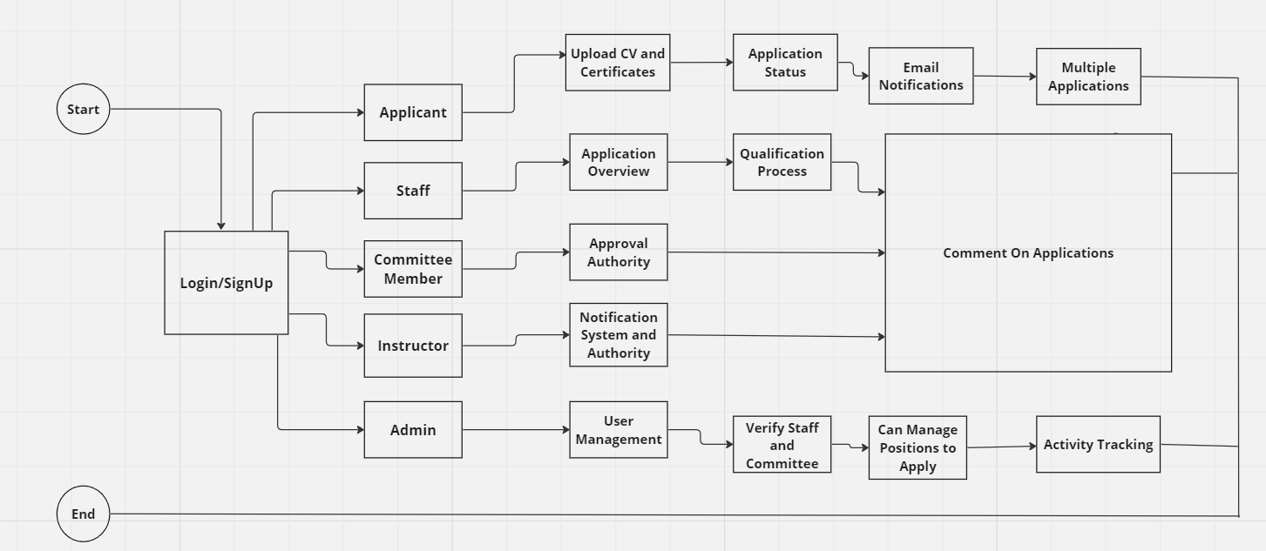
System Design

Slide 11
Technologies
Frontend GUI:
Tkinter 8.6.14
Python 3.11
Backend: Python 3.11
Database: MySql 8.1

Slide 12
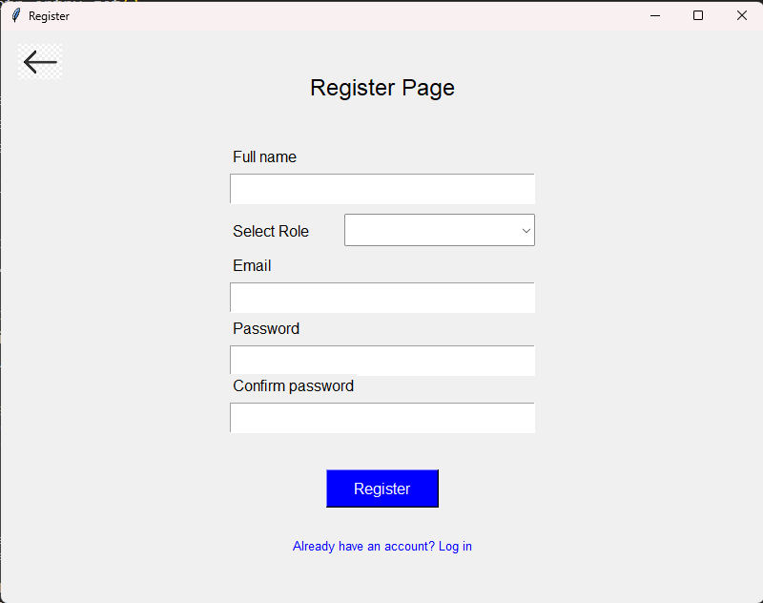
Implementation

Slide 13
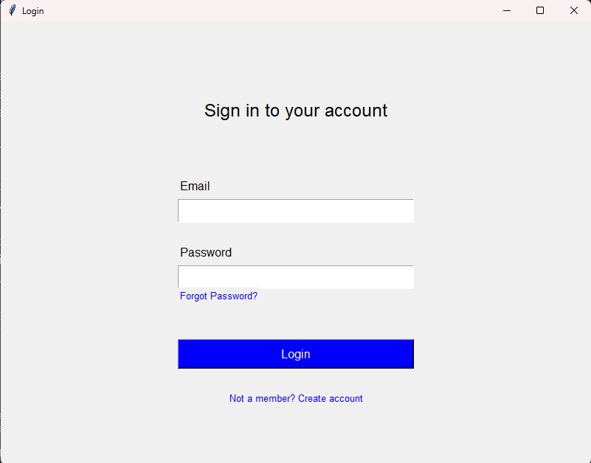

Slide 14
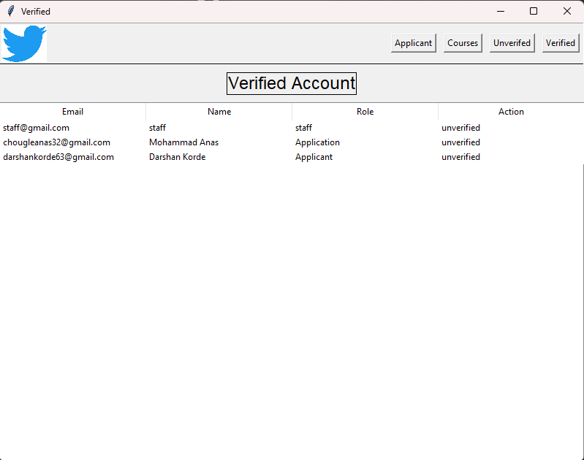

Slide 15
Conclusion
Our project aims to address challenges by implementing a comprehensive strategy to streamline the hiring process, focusing on improving efficiency, establishing clear evaluation criteria, enhancing communication, and ensuring transparency.
Elevating job hiring experience, selecting potential candidate by proving pre-screening process which helps in selecting best candidate. make this point short

Slide 16
References
[1] CAMPUS RECRUITMENT SYSTEM Arati Rizal, Monika Nirola, Shubham Kumar, Mr. Nirnay Pradhan
[2] A Comprehensive Campus Recruitment and Placement System for Optimizing the Hiring Process Jayesh Singh, Rasika Salvi, Jayesh Surve, Akanksha Sawant
[3] Berihun, Natnael. (2015). Requirement Analysis Document for Recruitment Management System.

Slide 17
Thank You...!!

